Slide 1
Meeting 09/03: Hot and Cold
Joren Janzing

Slide 2
Content
What are the events?
Composites: movie time!

Slide 3
Hot and cold events: How to define them?
Take 24 month rolling mean, detrend with 25 year rolling mean.
Physical threshold: - how to make this less arbitrary?
Composites are now aligned by first month of detection. What is the best physical way to do it? By their peak?

Slide 4
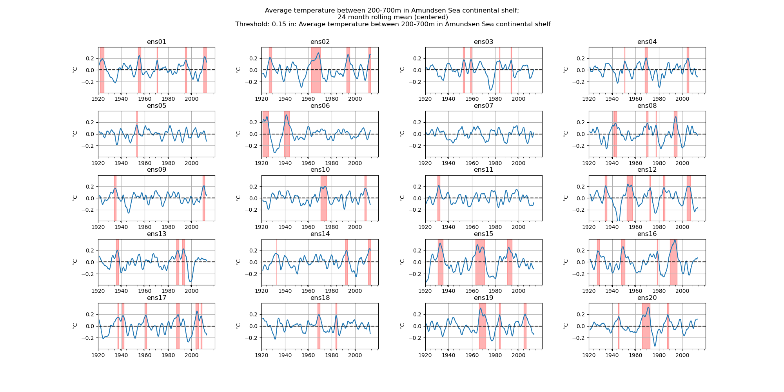

Slide 5
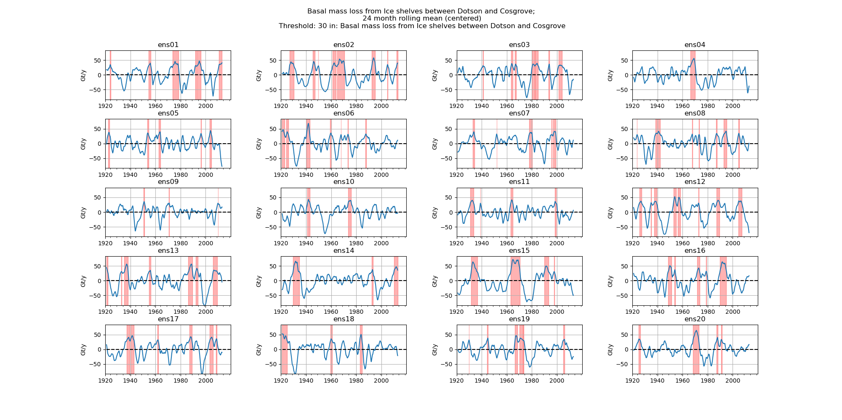

Slide 6
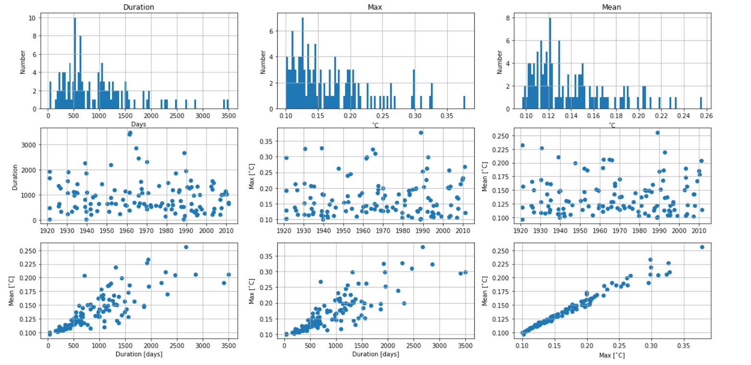

Slide 7
Sensitivity to threshold? Define based on melt?

Slide 8
What do they look like?
Composites!

Slide 9
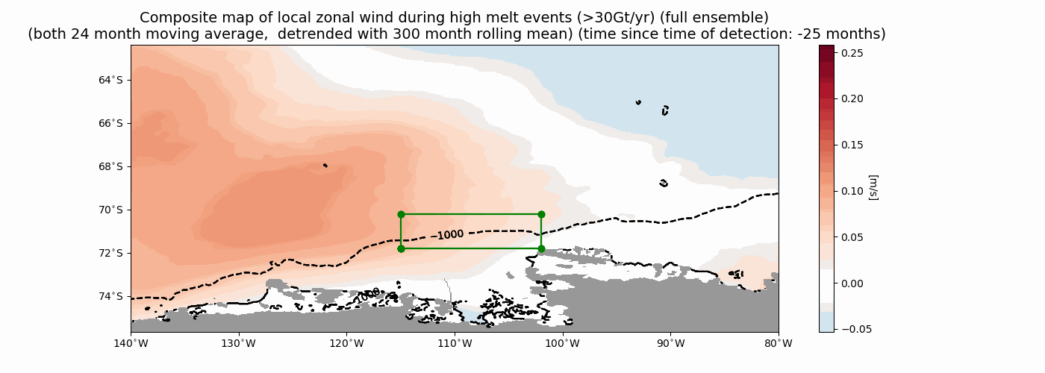
Wind High Melt

Slide 10
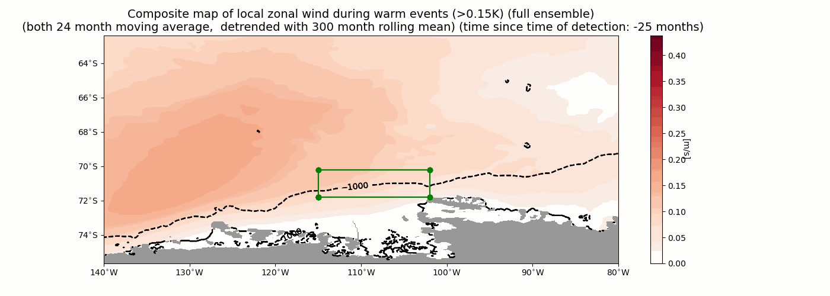
Wind Warm

Slide 11
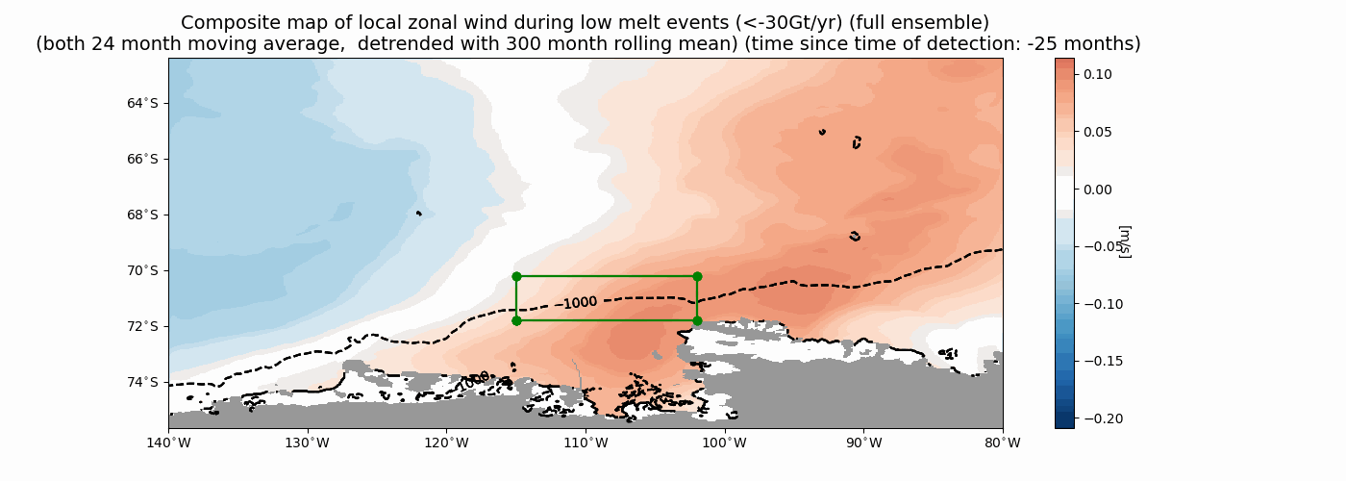
Wind Low Melt

Slide 12
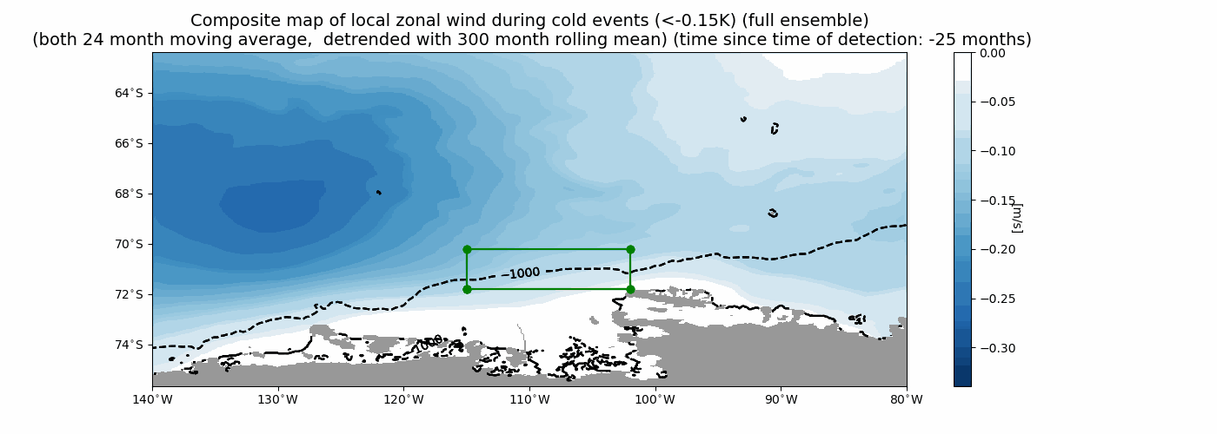
Wind Cold

Slide 13
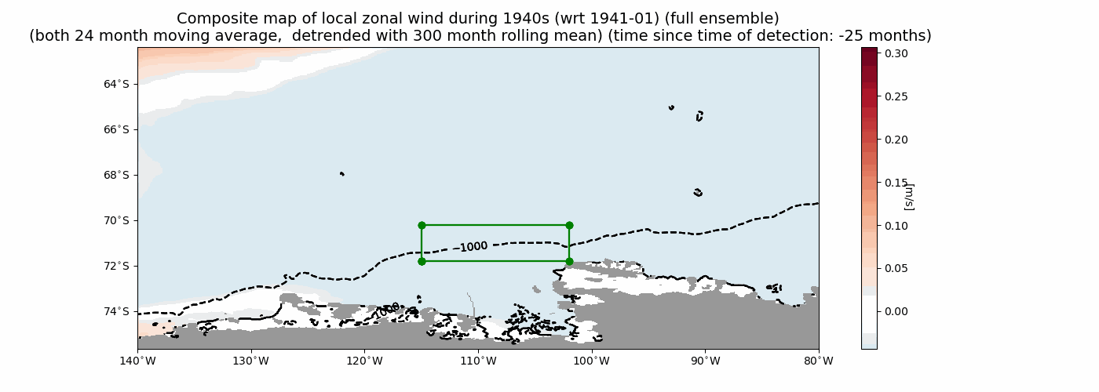
1940s!!

Slide 14
Winds during events:
Melt events: anomaly moves from west to east, focusses on the shelfbreak!
Temperature events: anomaly further off coast.

Slide 15
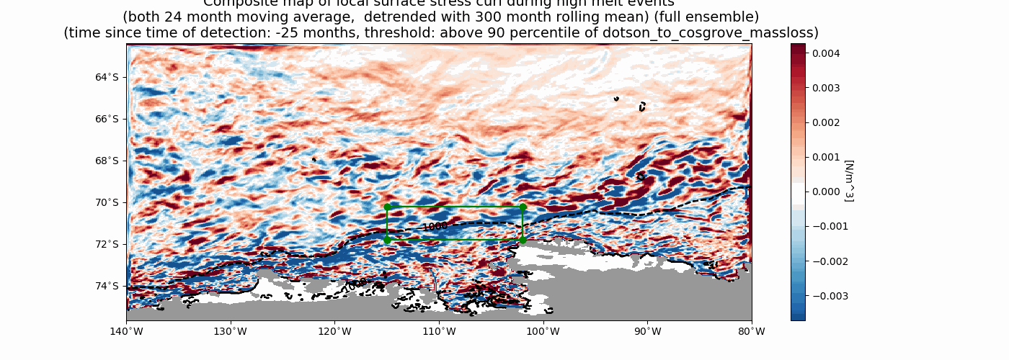
Curl High/Low

Slide 16
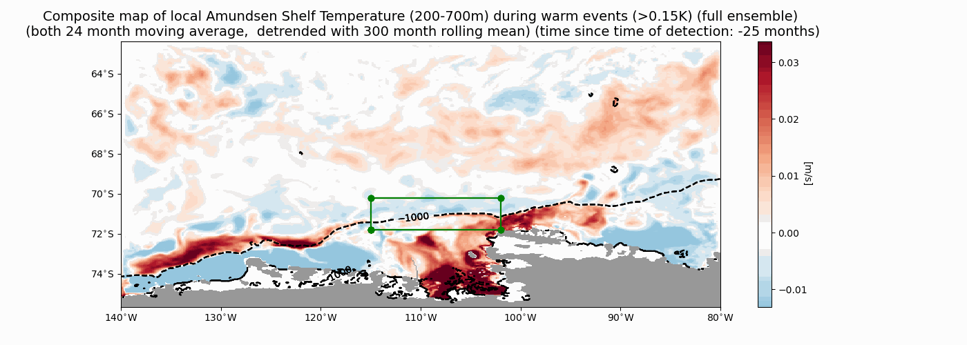
Temperature Warm

Slide 17
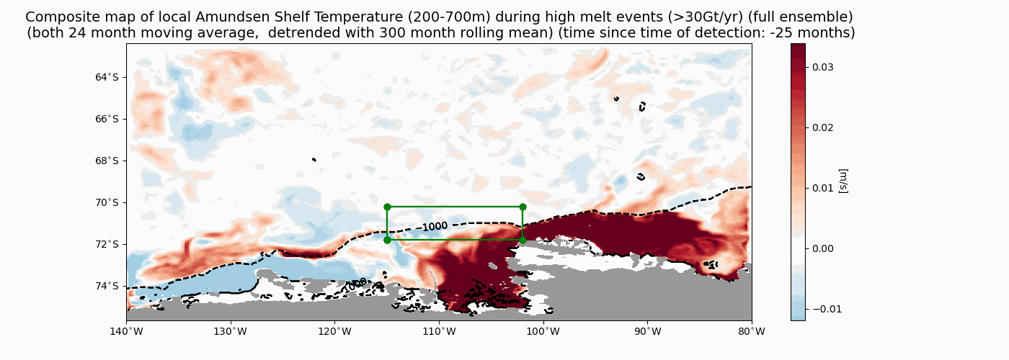
Temperature High melt

Slide 18
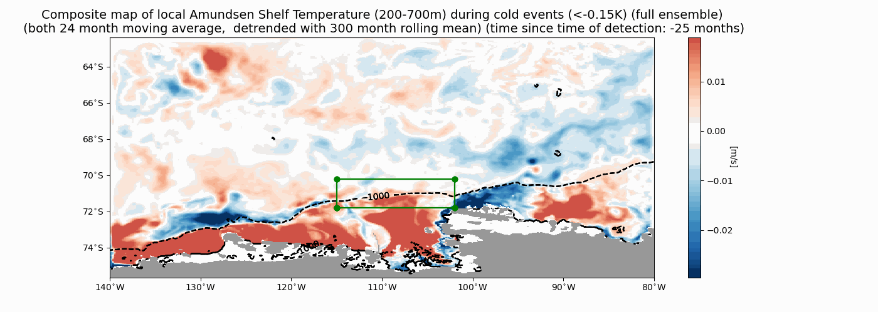
Temperature Cold

Slide 19
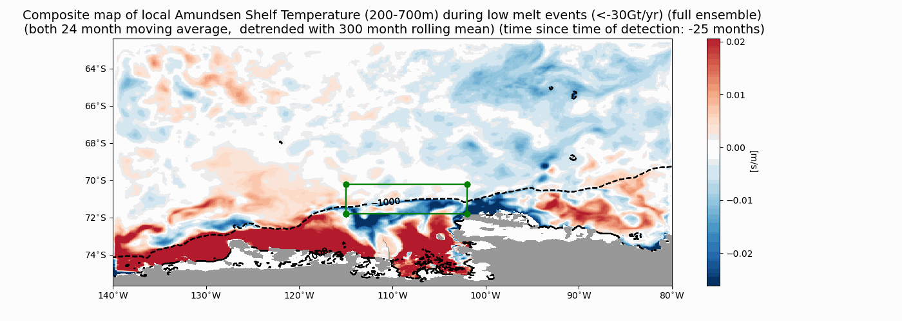
Temperature Low Melt

Slide 20
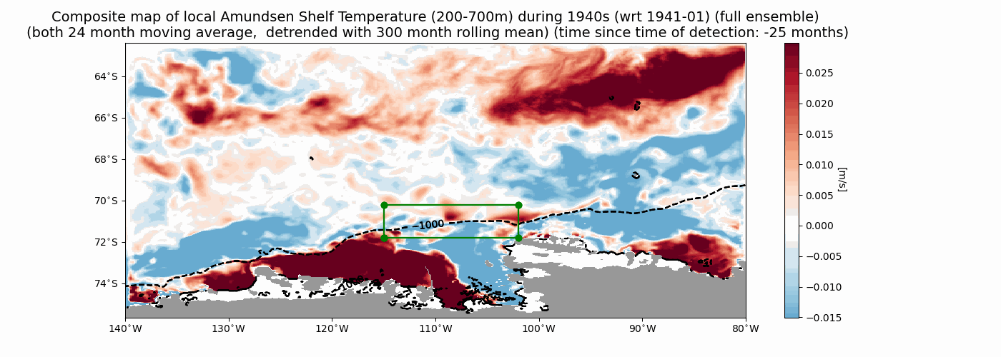
1940

